Slide 1
Ms. Hendricks’ World
Rules and Regulations
2020-2021

Slide 2
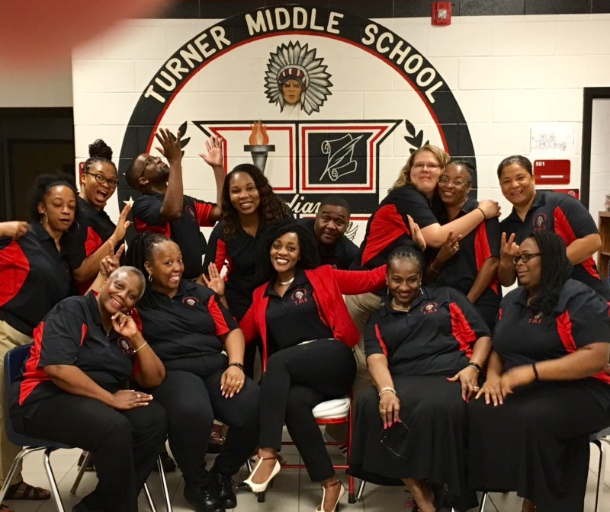
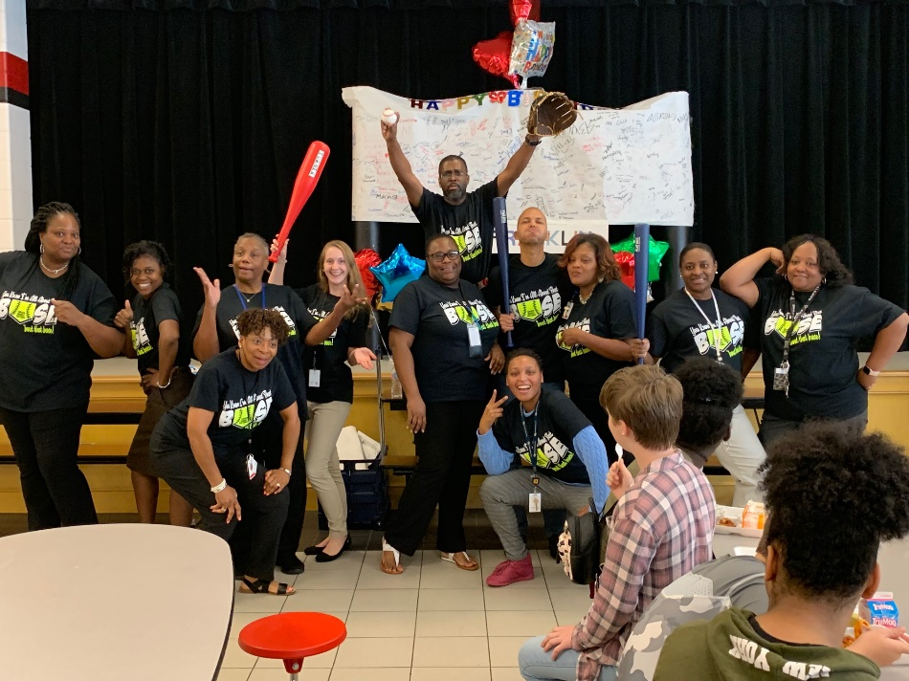
Welcome to the Magnificent 7!!

Slide 3
Home Room
You are with me the shortest time but this by no means excludes you from proper behavioral expectations.
Enter room quietly.
Eat breakfast and dispose of trash.
If you have made a mess, clean it up. We share this space, unnecessary mess leads to uncleanly surroundings which will bring bugs. Yuck!
Stand for Pledge and moment of silence. Be respectful and stand completely still and silent!
After announcements, gather your belongings, dispose of any final trash and prepare to exit the classroom in an orderly fashion, ready to embark on the days activities and your other classes.

Slide 4
Do’s
Do greet everyone with a smile and respectful demeanor
Attitudes are contagious, is yours worth catching?
Do participate
Do ask questions if anything is confusing or unclear
Do have all supplies out and ready once you have entered the classroom
Do raise your hands to speak out of turn or to ask questions unless otherwise authorized
Do remain in your seat unless you have been permitted to move about the classroom

Slide 5
Don’ts
Do not engage in hand play
Do not use foul language or make commentary that is offensive or belittling to your fellow classmates
Do not yell across the classroom
Do not speak out of turn
Do not leave the classroom without permission and the necessary hall pass
Do not use electronic devices without permission
If I see it, it is mine for the remainder of the period or day.

Slide 6
Teamwork makes the dream work
This is a safe learning environment. Let’s work together to have a productive and most of all exciting experience.
I expect the same level of respect I provide to you, from you.
Believe in yourself. You are all destined for great things!

Slide 7
Consequences Any violation of any of the above mentioned rules will be dealt with according to the guidelines set forth in our citation system
Citation 1 | Citation 2 | Citation 3 | Citation 4 | Citation 5 | Office Referral
Verbal Warning | Student/Teacher Conference w/Parent Contact (Optional: Silent Lunch) | After School Detention w/ Parent Contact | Team ISS w/Parent Contact | Parent Conference | Administrator Referral w/ Parent Contact
Late Arrival to Class
Arriving late to class is not recommended. However, if you are late after the second bell has rung, without a pass, please expect the following:
First Tardy is a verbal warning Second: Detention w/parent contact
Third: Detention w/parent contact Fourth and : Administrator referral

Slide 8
Class Communication
Class Website: https://mshendricks7thss.weebly.com/
Assignments
Documents
Contact
Supply Lists
Calendar and more…

Slide 9
Cheers to a great year!

